Slide 1
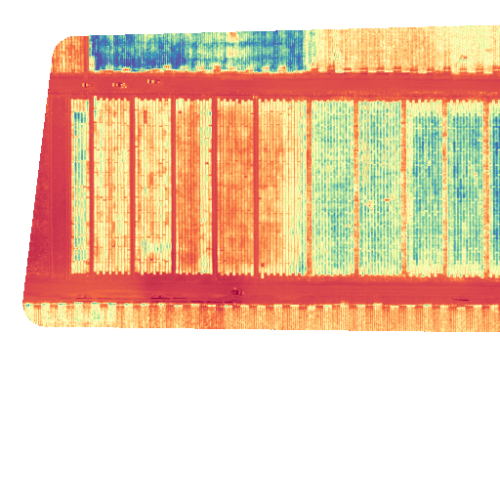
Drone Data in Agricultural Research
Notes:
I will try to touch on the many considerations you have to have when planning, collecting and processing drone data. The main focus will be how actually carry these things out not the theory behind them. If you have questions about why we are doing things a certain way feel free to ask and if we have time we can discuss some of these things.

Slide 2
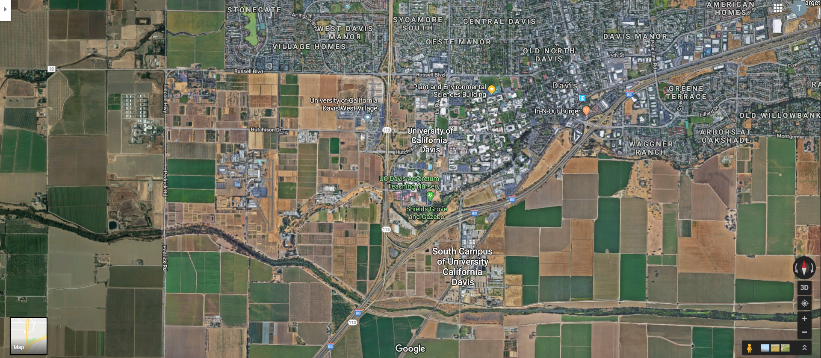
Site Choice
Source: GoogleMaps

Slide 3
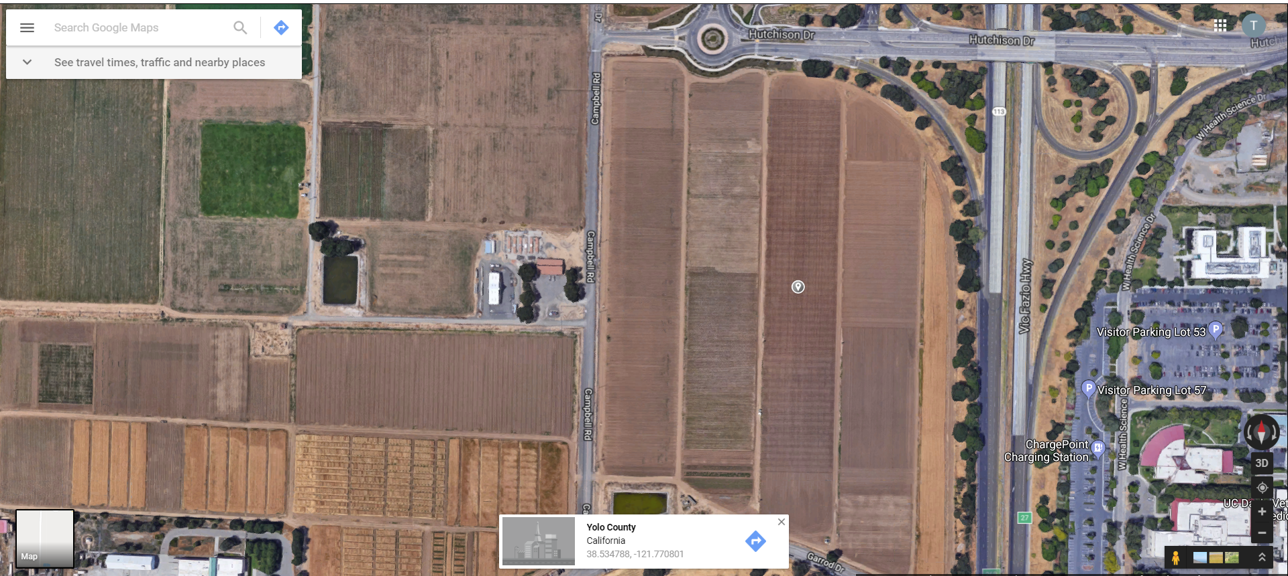
Source: GoogleMaps
Notes:
Airmap is also an app you can download on your phone.

Slide 4
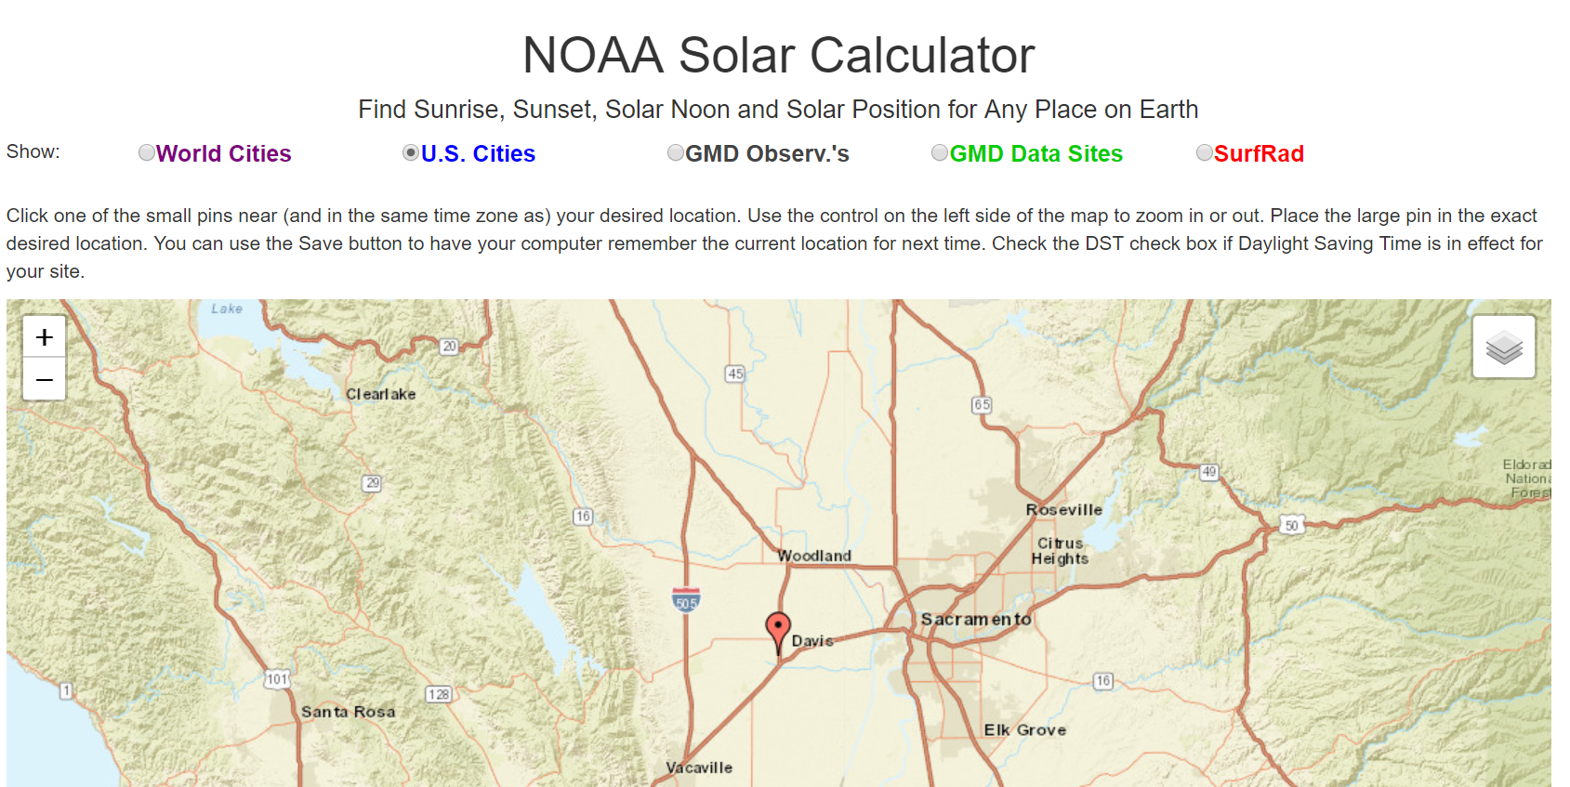
Source: NOAA
Notes:
Within 2.5 hours of solar noon – closer to it the less shadows

Slide 5
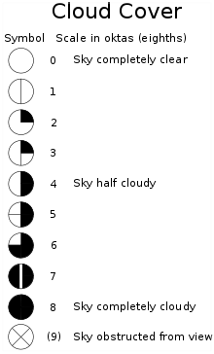
Source: Wikipedia
Notes:
Ask audience about when they think the cloud cover would be good to fly

Slide 6
Other flight condition considerations:
Heat
Rain
Wind
Power lines
Trees
Roads

Slide 7
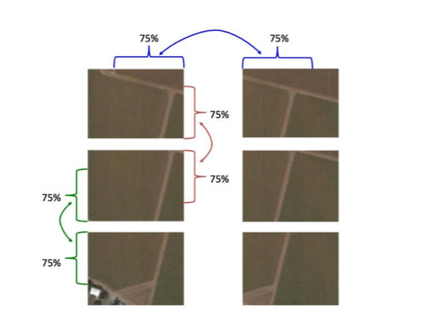
Overlap
Recommended at least 75% sidelap and front lap
Source: RedEdge-M User Manual

Slide 8
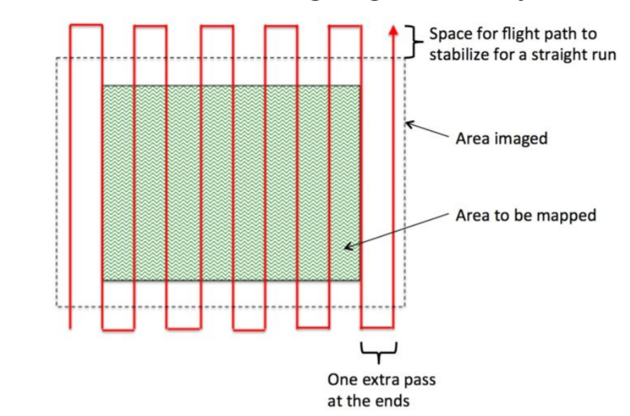
Flight Path
Perpendicular to rows
N/S direction
Tradeoff between height amount of time to capture
Source: RedEdge-M User Manual

Slide 9
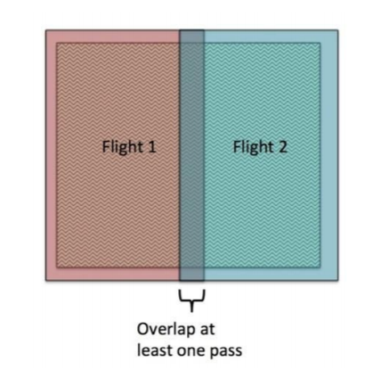
Large areas
Source: RedEdge-M User Manual

Slide 10
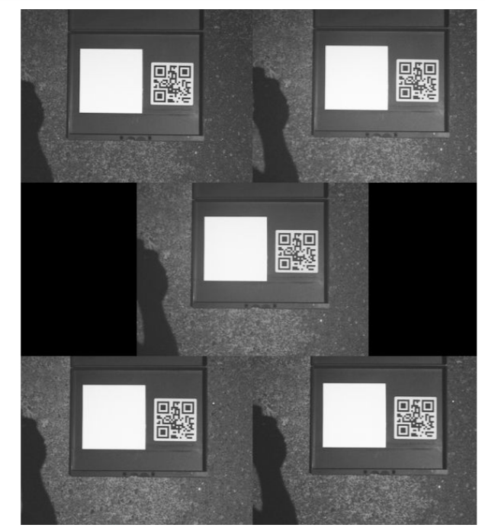
Camera Calibration
Source: RedEdge-M User Manual

Slide 11
Online Processing Options
MapsMadeEasy
DroneDeploy
Solvi
Precision Mapper
Notes:
Limited to small areas (or certain number of uploads)

Slide 12
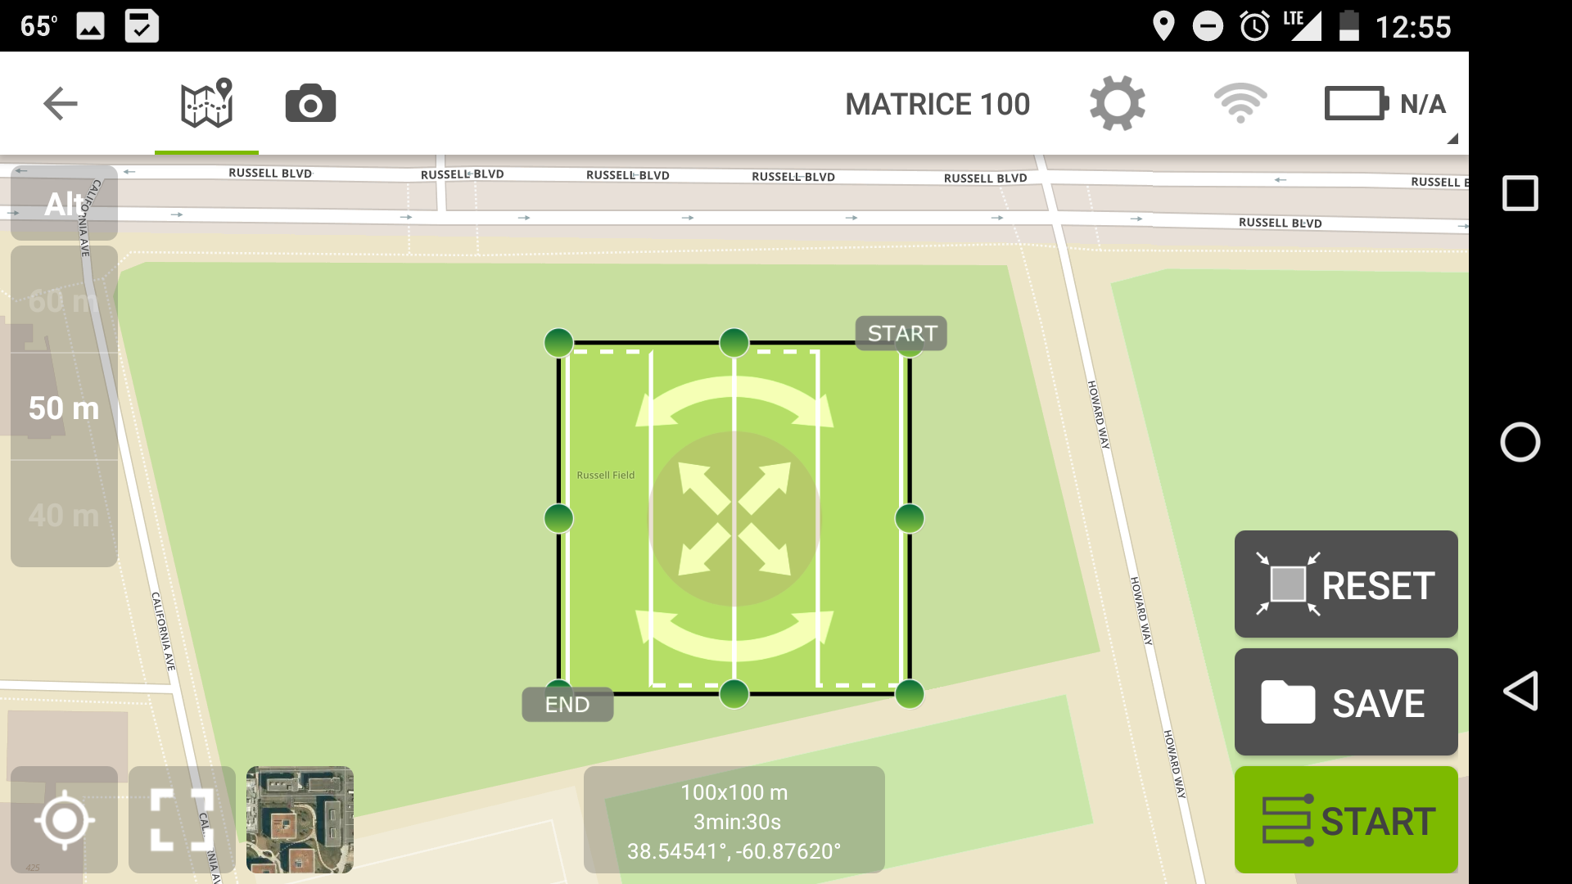
Mission Planning

Slide 13
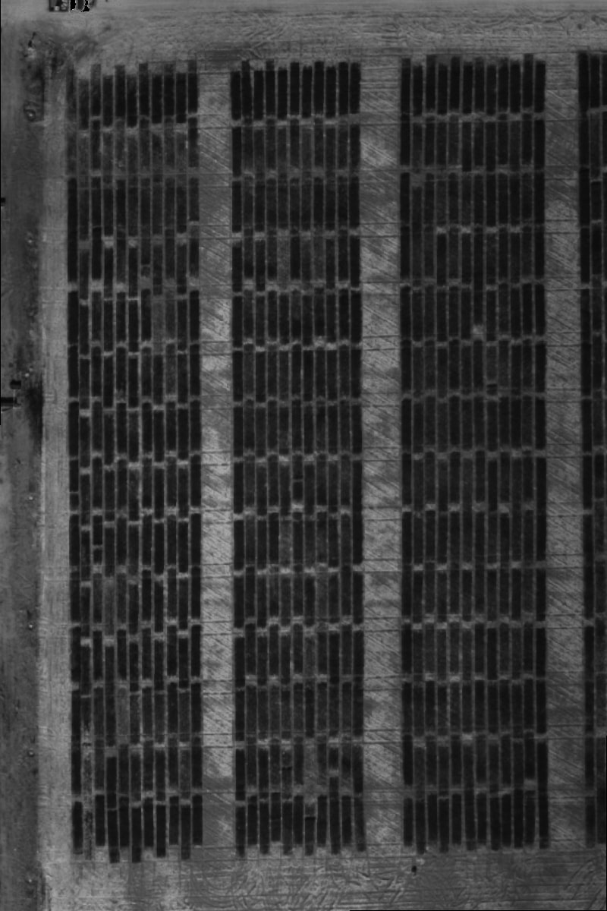
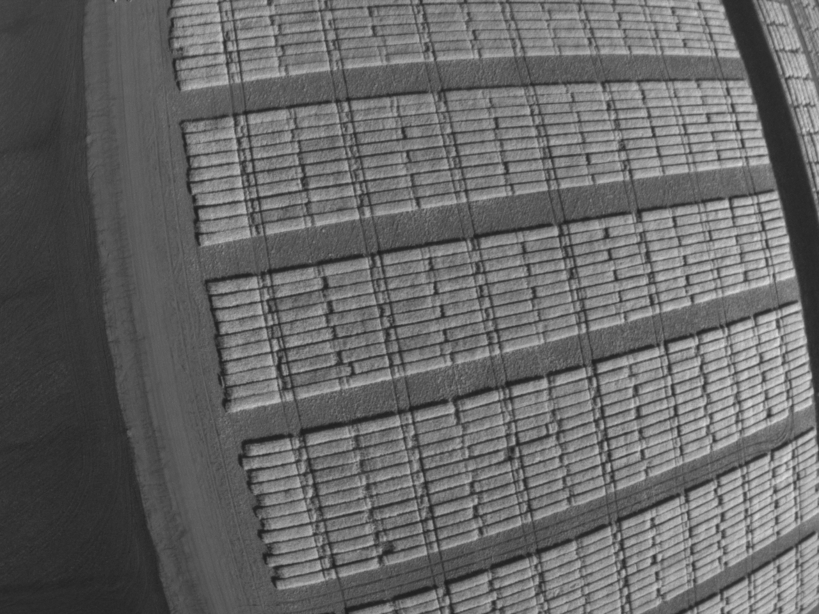
Image Processing

Slide 14
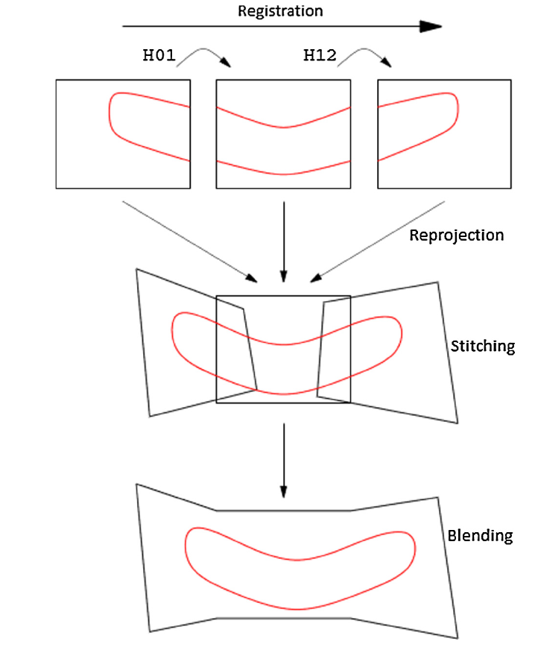

Slide 15
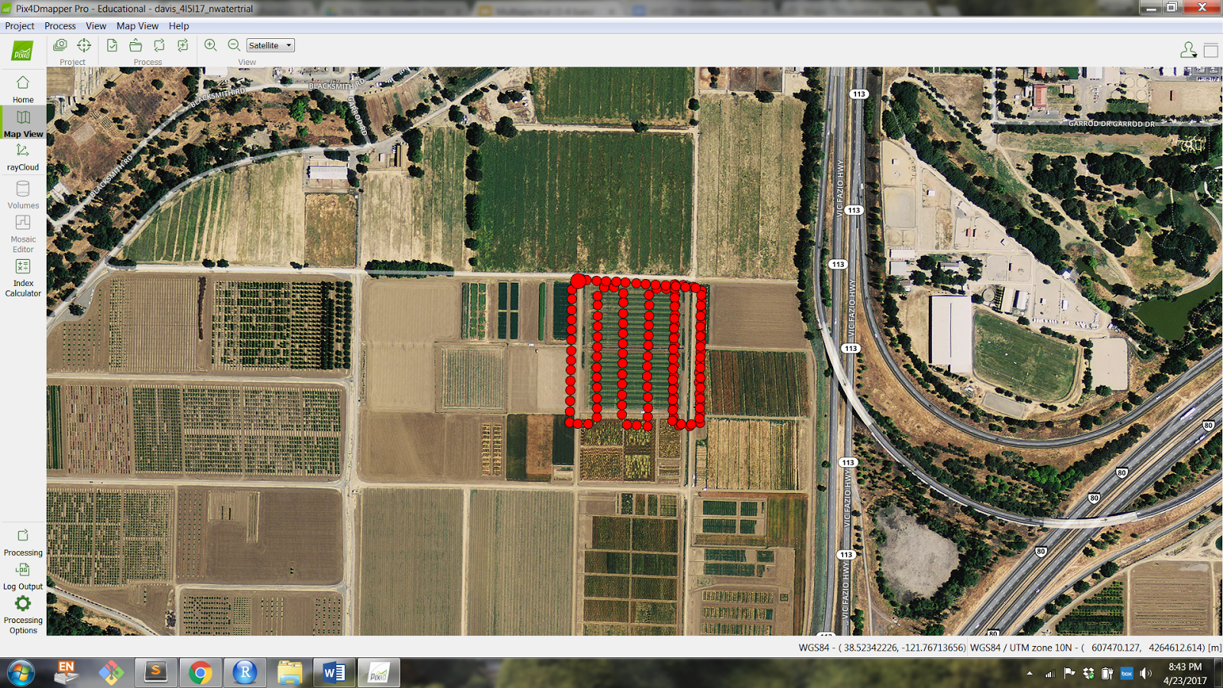

Slide 16
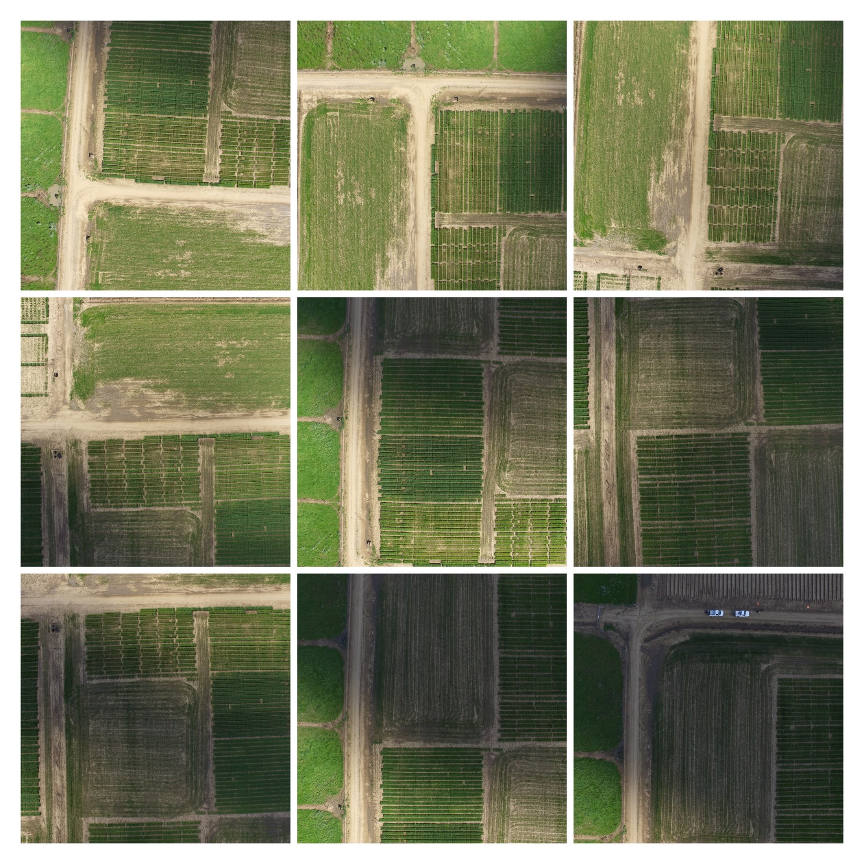

Slide 17
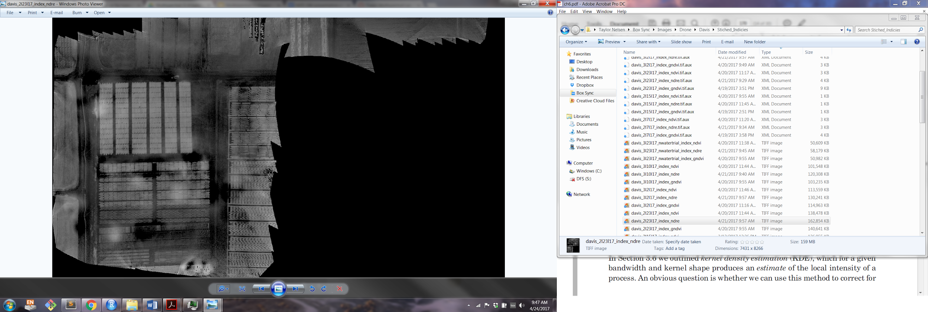

Slide 18
Drone Indices
Different combinations and ratios of values extracted from green, blue, red, red edge, and near infrared bands
Use two or more bands
Consider what indices you want to measure when selecting a multispectral camera
Can serve as estimates for canopy chlorophyll, biomass ground cover, plant stress, and more
Can change over growing season and be an indication of growth and senescence, disease, nutrient deficiency, etc.

Slide 19
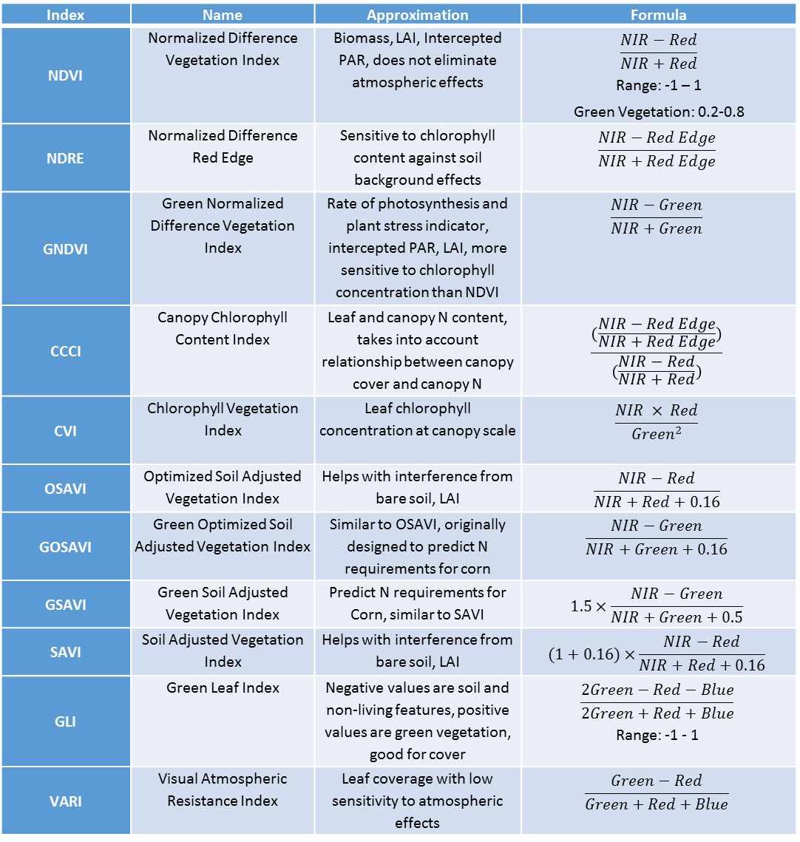
Index | Name | Approximation | Formula
NDVI | Normalized Difference Vegetation Index | Biomass, LAI, Intercepted PAR, does not eliminate atmospheric effects | $$\frac{NIR−Red}{NIR+Red}$$ Range: -1 – 1 Green Vegetation: 0.2-0.8
NDRE | Normalized Difference Red Edge | Sensitive to chlorophyll content against soil background effects | $$\frac{NIR−Red Edge}{NIR+Red Edge}$$
GNDVI | Green Normalized Difference Vegetation Index | Rate of photosynthesis and plant stress indicator, intercepted PAR, LAI, more sensitive to chlorophyll concentration than NDVI | $$\frac{NIR−Green}{NIR+Green}$$
CCCI | Canopy Chlorophyll Content Index | Leaf and canopy N content, takes into account relationship between canopy cover and canopy N | $$\frac{(\frac{NIR−Red Edge}{NIR+Red Edge})}{(\frac{NIR−Red}{NIR+Red})}$$
CVI | Chlorophyll Vegetation Index | Leaf chlorophyll concentration at canopy scale | $$\frac{NIR × Red}{{Green}^{2}}$$
OSAVI | Optimized Soil Adjusted Vegetation Index | Helps with interference from bare soil, LAI | $$\frac{NIR−Red}{NIR+Red+0.16}$$
GOSAVI | Green Optimized Soil Adjusted Vegetation Index | Similar to OSAVI, originally designed to predict N requirements for corn | $$\frac{NIR−Green}{NIR+Green+0.16}$$
GSAVI | Green Soil Adjusted Vegetation Index | Predict N requirements for Corn, similar to SAVI | $$1.5×\frac{NIR−Green}{NIR+Green+0.5}$$
SAVI | Soil Adjusted Vegetation Index | Helps with interference from bare soil, LAI | $$(1+0.16)×\frac{NIR−Red}{NIR+Red+0.16}$$
GLI | Green Leaf Index | Negative values are soil and non-living features, positive values are green vegetation, good for cover | $$\frac{2Green−Red−Blue}{2Green+Red+Blue}$$ Range: -1 - 1
VARI | Visual Atmospheric Resistance Index | Leaf coverage with low sensitivity to atmospheric effects | $$\frac{Green−Red}{Green+Red+Blue}$$

Slide 20
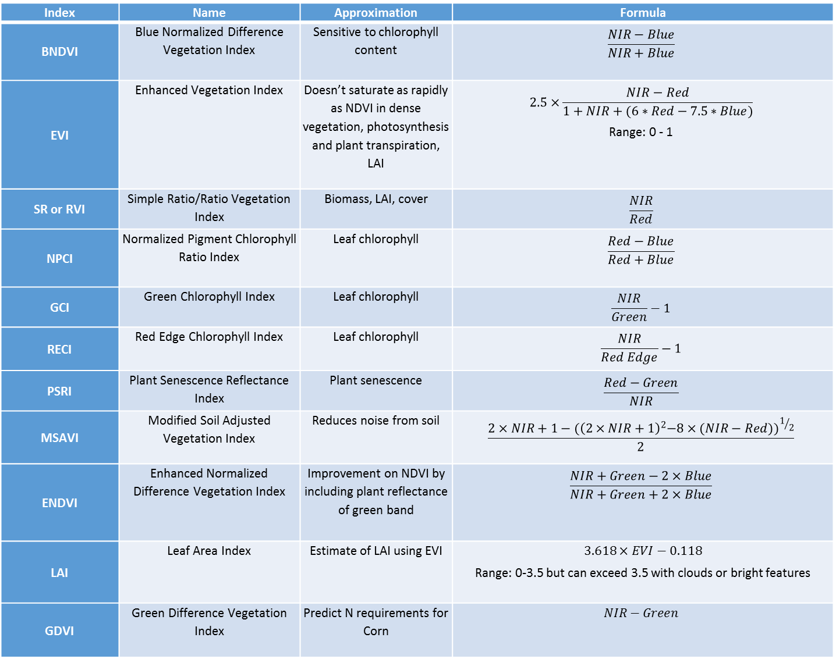
Index | Name | Approximation | Formula
BNDVI | Blue Normalized Difference Vegetation Index | Sensitive to chlorophyll content | $$\frac{NIR−Blue}{NIR+Blue}$$
EVI | Enhanced Vegetation Index | Doesn’t saturate as rapidly as NDVI in dense vegetation, photosynthesis and plant transpiration, LAI | $$2.5×\frac{NIR−Red}{1+NIR+(6∗Red−7.5∗Blue)}$$ Range: 0 - 1
SR or RVI | Simple Ratio/Ratio Vegetation Index | Biomass, LAI, cover | $$\frac{NIR}{Red}$$
NPCI | Normalized Pigment Chlorophyll Ratio Index | Leaf chlorophyll | $$\frac{Red−Blue}{Red+Blue}$$
GCI | Green Chlorophyll Index | Leaf chlorophyll | $$\frac{NIR}{Green}−1$$
RECI | Red Edge Chlorophyll Index | Leaf chlorophyll | $$\frac{NIR}{Red Edge}−1$$
PSRI | Plant Senescence Reflectance Index | Plant senescence | $$\frac{Red−Green}{NIR}$$
MSAVI | Modified Soil Adjusted Vegetation Index | Reduces noise from soil | $$\frac{2×NIR+1−{(\left(2×NIR+1\right)}^{2}−8×{(NIR−Red))}^{1/2}}{2}$$
ENDVI | Enhanced Normalized Difference Vegetation Index | Improvement on NDVI by including plant reflectance of green band | $$\frac{NIR+Green−2×Blue}{NIR+Green+2×Blue}$$
LAI | Leaf Area Index | Estimate of LAI using EVI | $$3.618×EVI−0.118$$ Range: 0-3.5 but can exceed 3.5 with clouds or bright features
GDVI | Green Difference Vegetation Index | Predict N requirements for Corn | $$NIR−Green$$

Slide 21
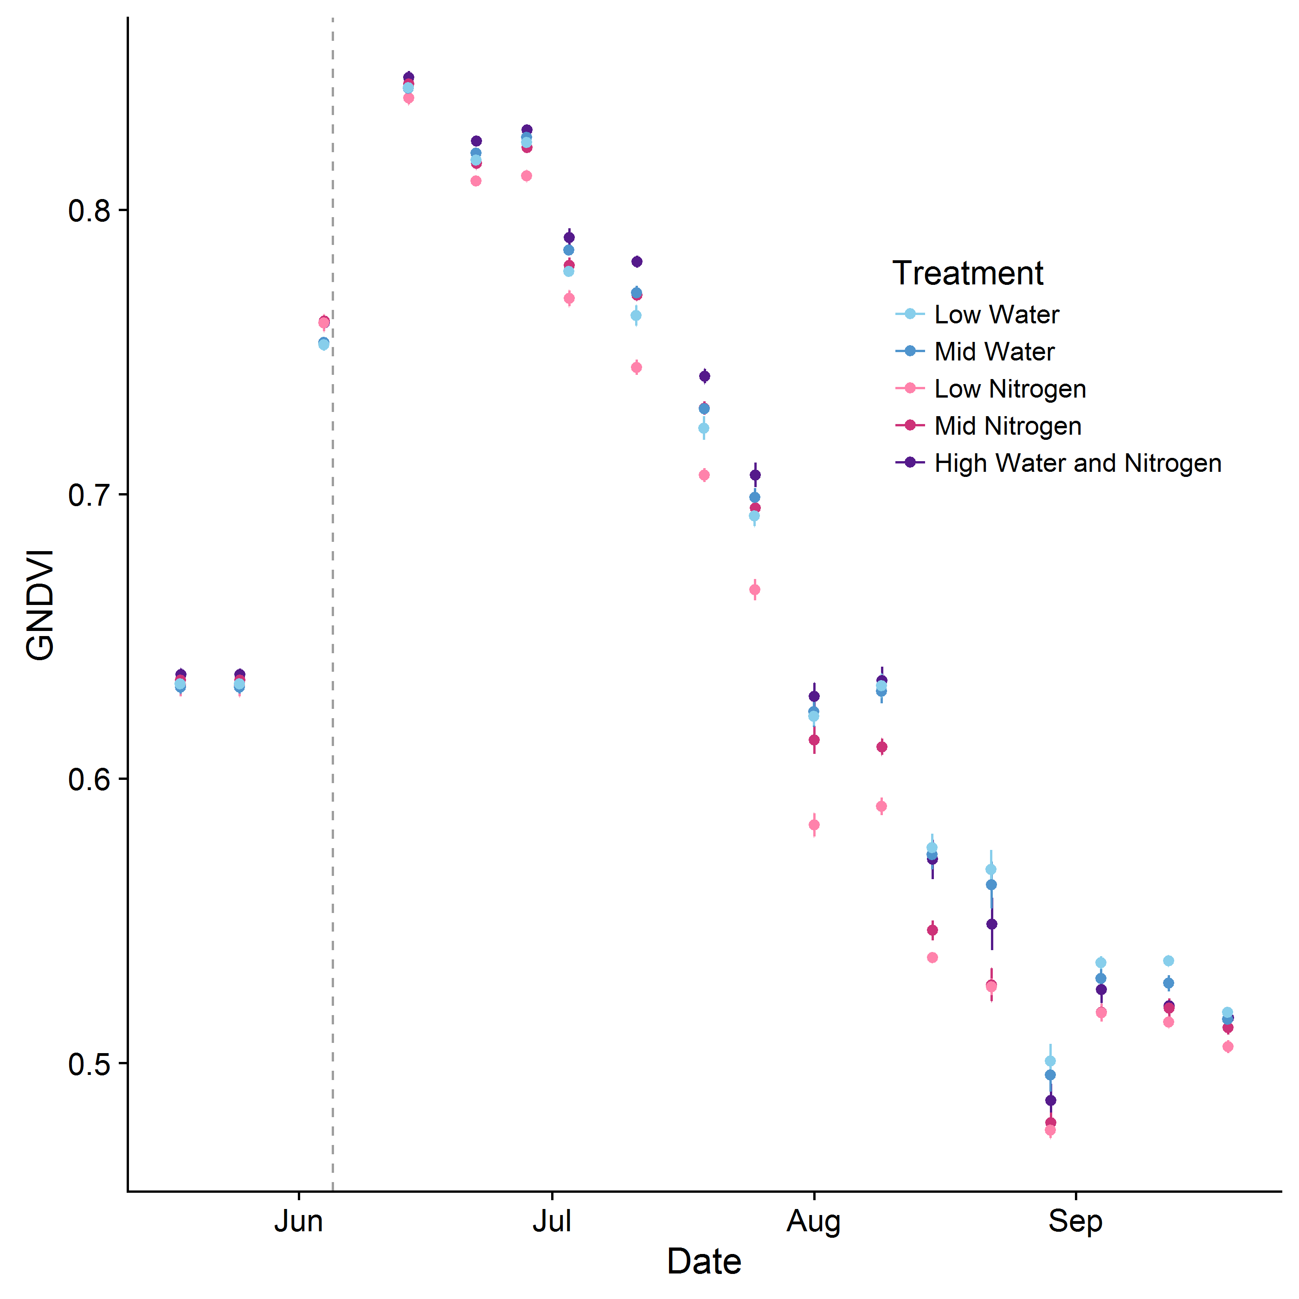
Example showing change over time in GNDVI for a corn crop with different stress treatments:

Slide 22
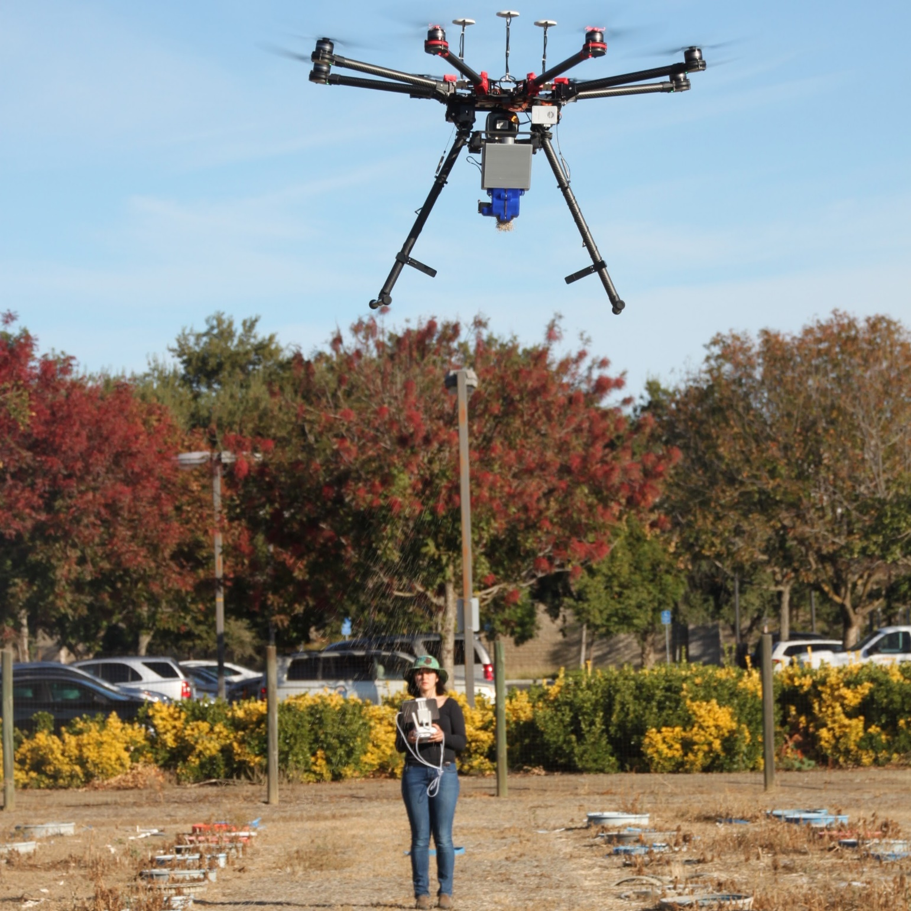
Taylor Nelsen
tsnelsen@ucdavis.edu
(919) 949 – 8725
Sean Hogan
sdhogan@ucanr.edu
(530) 750-1322
Brandon Stark, UC Merced UASSafety@ucmerced.edu (209) 201-2051 erm@ucop.edu to be added to the UC-UAS-RESEARCH-L listserv
Center for Spatial Sciences
aimandel@ucdavis.edu

